Slide 1
California’s Redwood Coast: Exploring the Roots of Health Disparities
California Center for Rural Policy at Cal Poly Humboldt
Author: Schuyler Kirsch
Presenter: Leigh Pierre-Oetker
Notes:
Background photo: Point Arena Lighthouse in Mendocino

Slide 2
The California Center for Rural Policy (CCRP) at Cal Poly Humboldt is a research, evaluation, and policy center focused on improving the health and well-being of rural people and environments.
Cal Poly Humboldt’s California Center for Rural Policy is dedicated to improving the lives of rural people in California. Using methods tailored to the study of rural populations, environments, and their interactions, the CCRP researches a wide range of issues to inform policies and planning.
Data on rural communities is often generated through urban methodology. CCRP, however, is a research center created for and by rural communities. We are committed to improving the health and environment of rural people through our research, which is based on innovative methods and provides detailed assessments. Our goal is to make recommendations that will inform decisions and policies.

Slide 3
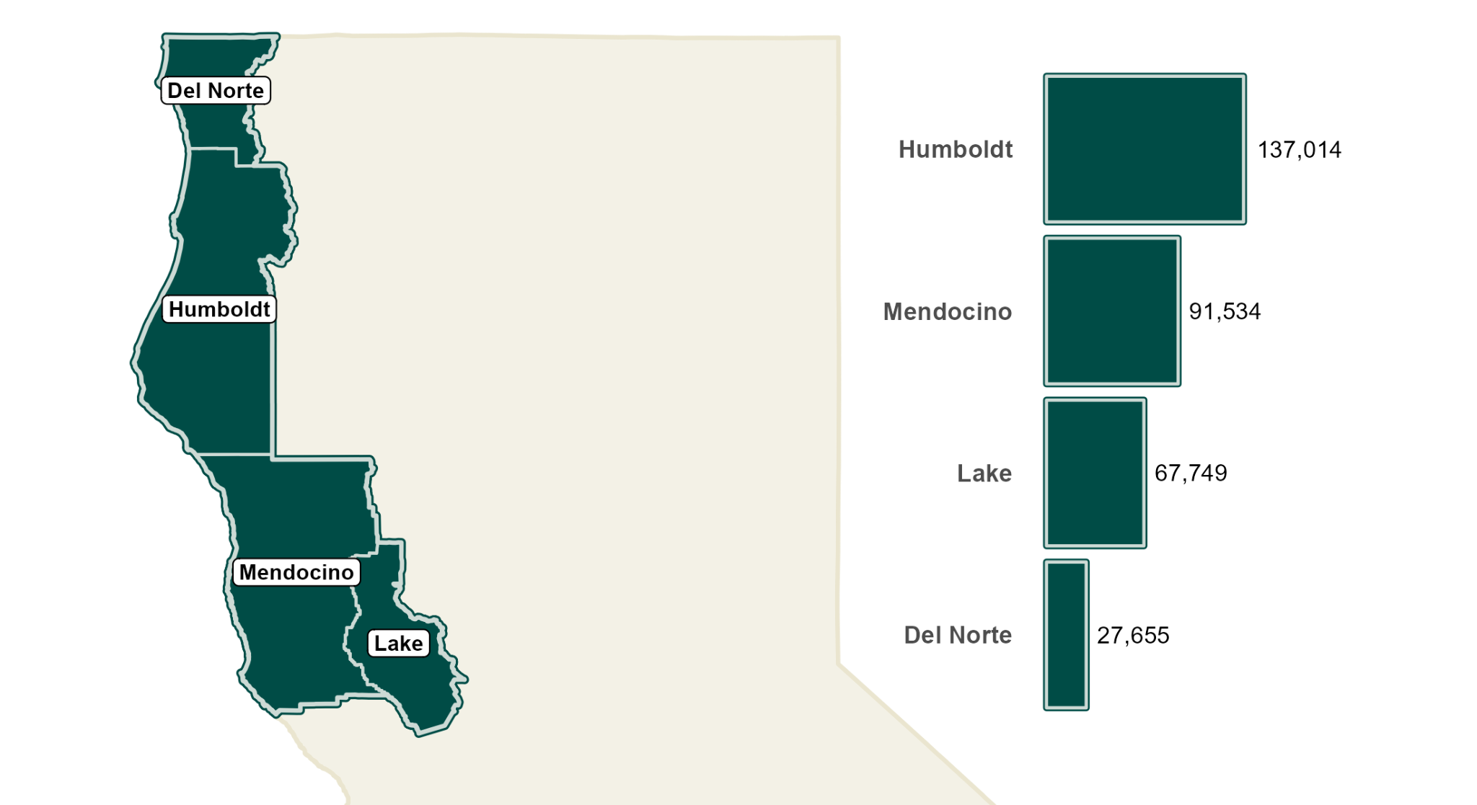
Objective and Overview
Objective: Identify health inequities between the Redwood Coast region and state averages to help direct attention and resources towards addressing high-priority health challenges and vulnerable populations.
Data: American Community Survey (ACS) 2017-2021
Notes:
The Redwood Coast population is considerably older compared to the state average.
The region is primarily populated by white, non-Hispanic individuals, who constitute 67.7% of the total regional population— almost double the statewide proportion of 35.8% for this group.
The American Indian and Alaskan Native (AIAN) population is proportionately higher than the state population, representing 2.4% of the Redwood Coast population as opposed to only 0.3% of the statewide population.

Slide 4
Conceptual Framework
This report takes inspiration from a framework developed by the Bay Area Regional Health Inequities Initiative (BARHII), but works backwards starting with adverse health disparities between the region and the state averages.
Notes:
The BARHII framework posits that reducing health inequities requires looking at disparities in Environmental, Institutional, Economic, or Social Factors (upstream factors), and how they perpetuate inequities in risk factors and thus, inequities in health outcomes (downstream factors).
“Why does the report work backwards from this framework?” Working backwards from this framework allows us to determine a set of health outcomes where there is significant and adverse disparity between the region and state to provide a more targeted look at risk factors contributing to these disparities.

Slide 5
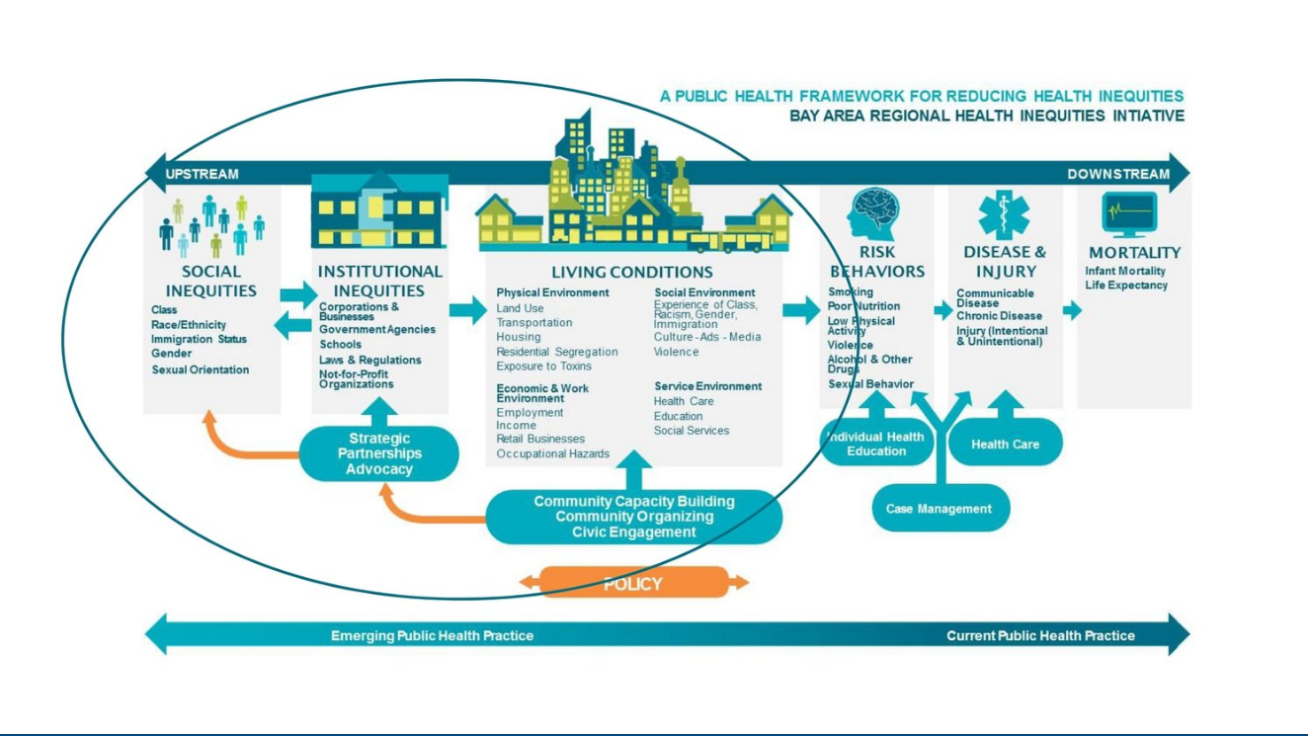
Conceptual Framework
Notes:
The BARHII framework posits that reducing health inequities requires looking at disparities in Environmental, Institutional, Economic, or Social Factors (upstream factors), and how they perpetuate inequities in risk factors and thus, inequities in health outcomes (downstream factors).
“Why does the report work backwards from this framework?” Working backwards from this framework allows us to determine a set of health outcomes where there is significant and adverse disparity between the region and state to provide a more targeted look at risk factors contributing to these disparities.

Slide 6
Overview of Health Outcomes

Slide 7
Premature death is higher and life expectancy is lower
Data: County Health Rankings and Roadmaps (CHRR), 2018-2020
Notes:
Mendocino, when compared to the rest of the Redwood Coast Region, is experiencing less severe premature death and life expectancy when compared to their counterparts.
Premature death is defined as death occurring before the age of 75.
Age-adjusted rates are used to make comparisons between groups with different age distributions. They are summary measures adjusted for differences in age distributions.

Slide 8
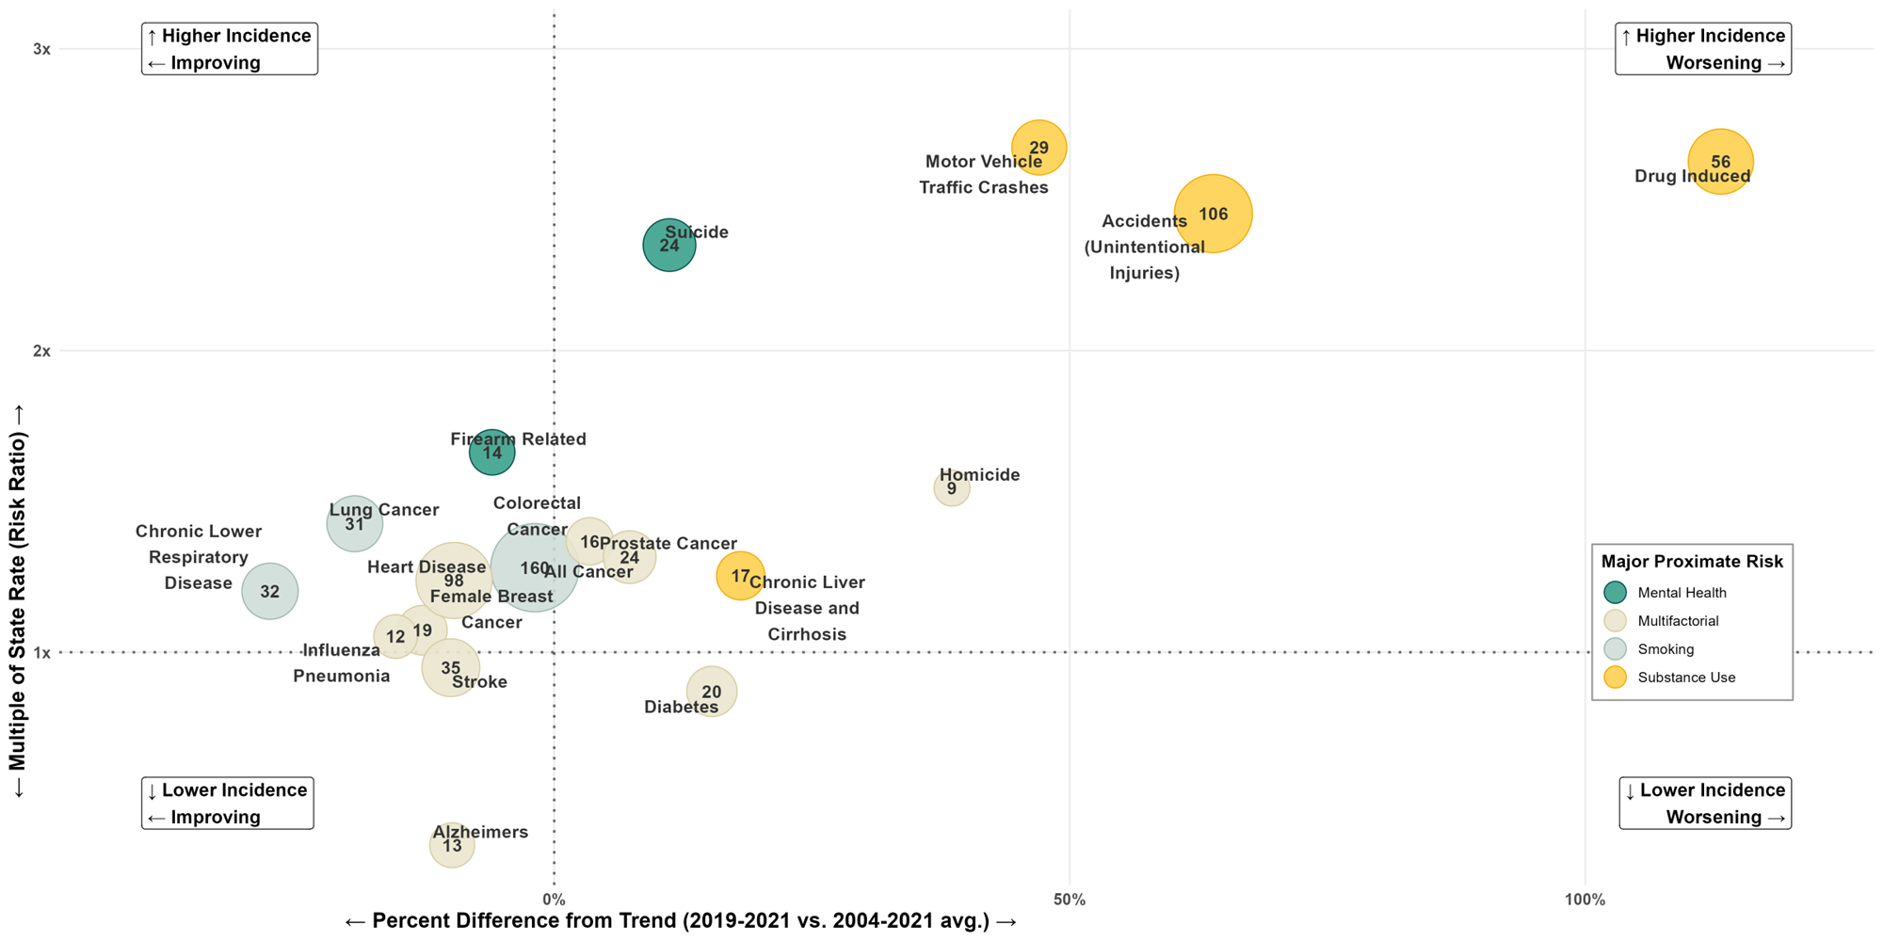
Age-Adjusted Mortality Rates per 100,000 for Mendocino County
Data: Mortality Rates, CDPH, County Health Status Profiles.
Notes:
Important to note that this chart solely focuses on health outcomes of Mendocino County. Not the Redwood Coast Region.
How to read this cluster chart. If an outcome is placed in the:
Upper left quadrant, then the outcome is happening at a higher rate than the state, but trends are improving.
Upper right quadrant, then the outcome is happening at a higher rate than the state, but trends are worsening.
Lower left quadrant, then the outcome is happening at a lower rate than the state, but trends are improving.
Lower right quadrant, then the outcome is happening at a lower rate than the state, but trends are worsening.
Takeaway: The most substantial adverse health disparities between Mendocino and the state are evident in rates of drug induced deaths, unintentional injuries, motor vehicle deaths, suicide, and fire-arm related deaths.

Slide 9
Other Health Outcomes
Data reveals moderately elevated rates of asthma, heart disease, and obesity in Humboldt, Mendocino, and Lake counties compared to the state.
Morbidities, Percent of Population. Humboldt, Mendocino, Lake Counties (HML).
Data: California Health Information Survey (CHIS), Blood Pressure 2019-2022, All Other 2011-2022.
Notes:
Important to note that these are moderately elevated rates and aren’t significantly worse than the state.

Slide 10
Significantly Higher Rates of Disability
Disability rates are higher than the state average across the region. While the aging population is a contributing factor, it’s noteworthy that even among individuals aged 18 to 34, disability rates are significantly higher than the state average.
Disability Rates
Data: American Community Survey (ACS) 2017-2021
Notes:
This report uses the disability definitions from the American Community Survey (ACS). Disability includes both physical and mental health disabilities.
Cognitive: ‘due to physical, mental, or emotional condition: “serious difficulty concentrating, remembering, or making decisions”’
Independent living: ‘due to physical, mental, or emotional condition, difficulty: “doing errands alone such as visiting a doctor’s office or shopping”’
Ambulatory: “serious difficulty walking or climbing stairs”
Self-care: “difficulty dressing or bathing”
Vision: “blind or … serious difficulty seeing even when wearing glasses”
Hearing: “deaf or … serious difficulty hearing”
Takeaway: Rates of disability are much higher than state averages in Mendocino County and the region as a whole, even among young adults.

Slide 11
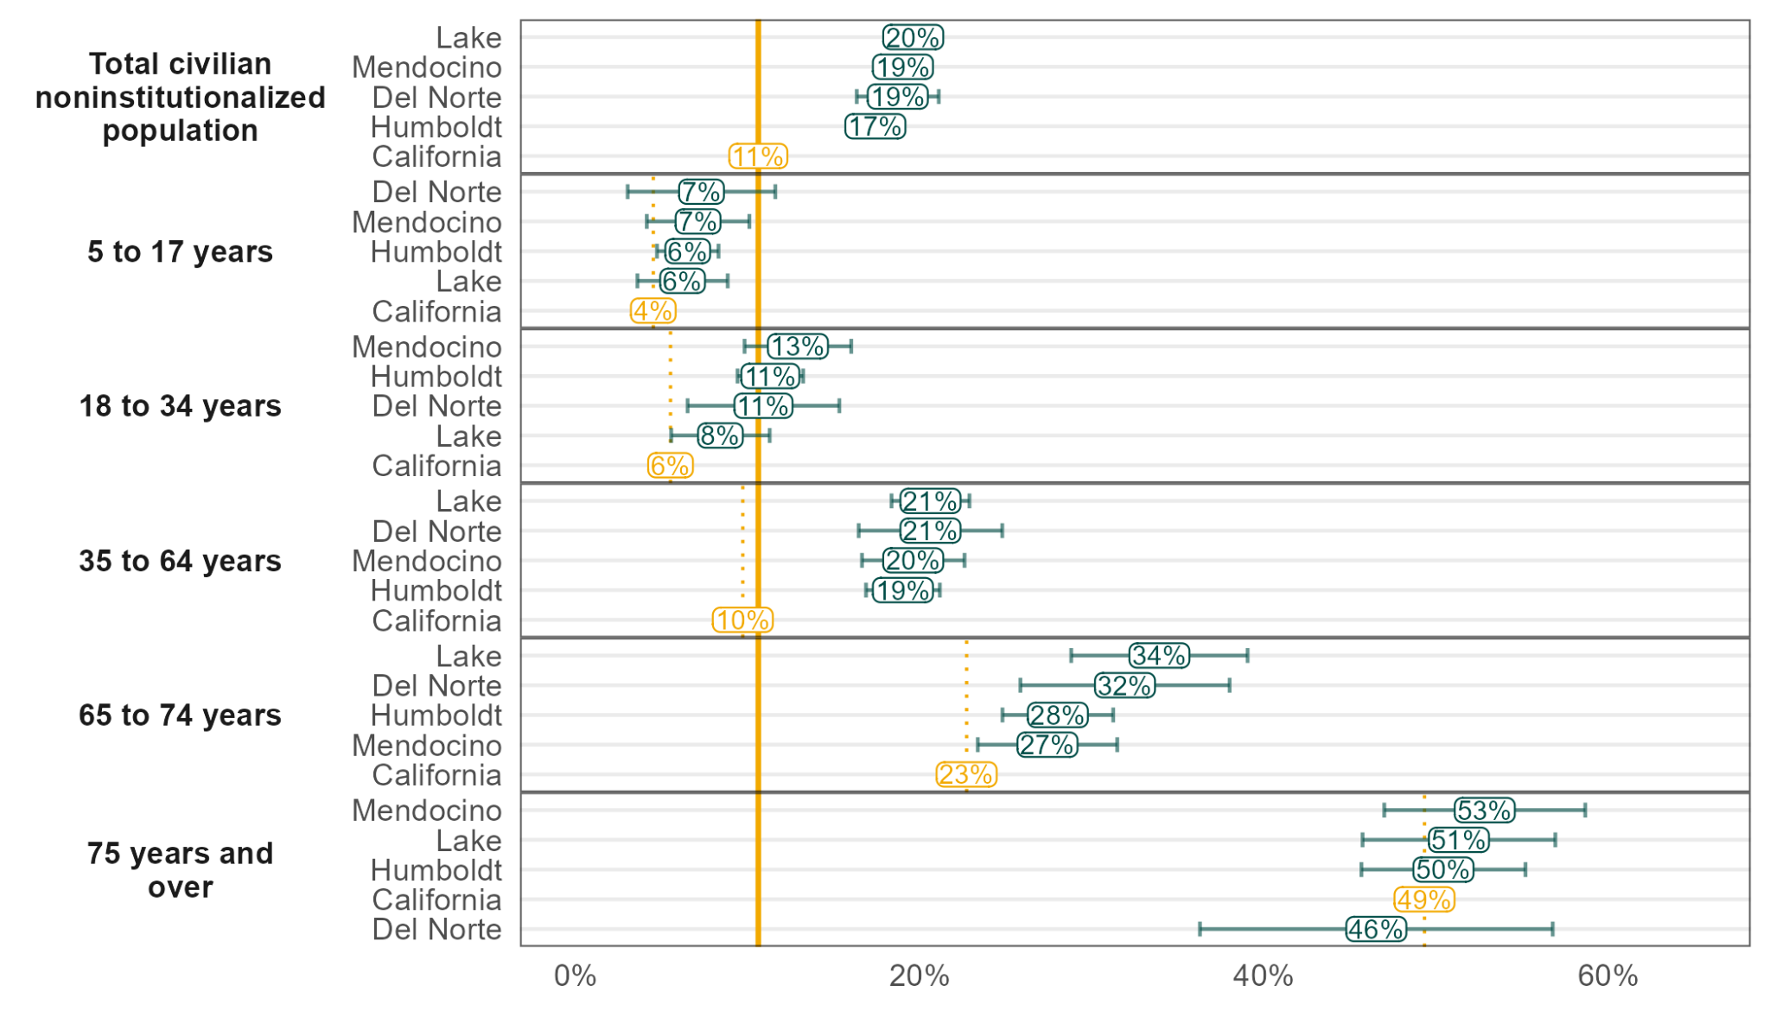
Significantly Higher Rates of Disability
Disability Rates by Age
Data: American Community Survey (ACS) 2017-2021

Slide 12
“Proximate”Risk Factors
Notes:
Proximate risk factors: risk factors which are directly linked to health outcomes (example: the role of smoking in lung cancer).
Identifying proximate factors allows for a more focused approach to exploration of deeper factors as well as a more focused approach to policy solutions.

Slide 13
Substance Use Likely Contributes Substantially to Mendocino’s Elevated Mortality Rates
Binge Drinking in Past Year (Left 2021 - 2022, Right 2011 -2015)
Rates of liver disease deaths are elevated in the region. Heavy alcohol consumption is a leading risk factor for liver disease. Multiple data sources collectively signal higher rates of excessive drinking.
Data: California Health Information Survey (CHIS)
Alcohol Use Indicators (Adult Excessive Drinking 2020, Youth Data 2017-2019)
Data: Adult Estimate from CHRR, Youth Data sourced from CalSCHLS
Notes:
SAE stands for Small Area Estimation. Small Area Estimation techniques are used to estimate health outcomes and behaviors for smaller populations by using other sets of data. As SAE data is helpful, data providers caution against using the estimates to detect effects due to local area interventions, as those effects won’t necessarily be reflected in the data used to construct the SAE data.
Binge drinking is defined as five or more drinks for males and four or more for females within two hours.
Significant youth disparity in Mendocino county for substance use.

Slide 14
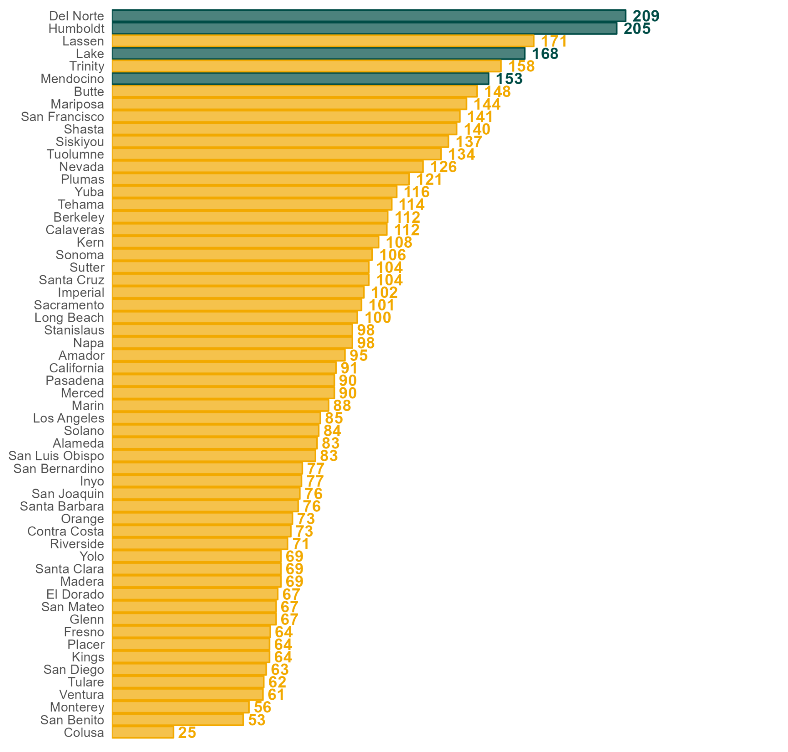
Hepatitis C Contributes to Liver Disease
Newly Reported Chronic Hepatitis C per 100,000 Population
Hepatitis C is another risk factor for liver disease, and is primarily transmitted through sharing needles.
Rates of Hepatitis C in Mendocino County, and in the greater Redwood Coast Region, are the highest in the state.
Data: CDPH, Rates are averaged over 2014, 2016, and 2018

Slide 15
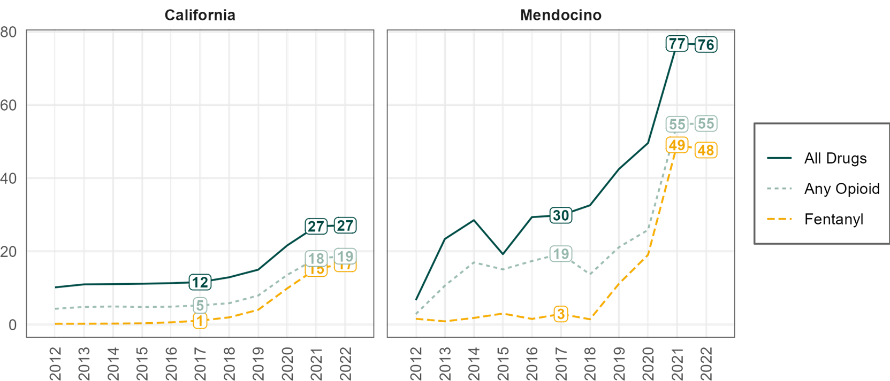
Fentanyl Contributes to Spike in Overdose Deaths
Fentanyl has contributed substantially to the rise in drug overdose deaths in Mendocino County, starting around 2018. Fentanyl deaths account for over half of statewide overdose deaths, and account for roughly half of drug overdose deaths in the Redwood Coast region.
Age-Adjusted Drug Overdose Mortality Rates per 100,000, Mendocino County
Data: CDPH Overdose Surveillance Dashboard
Notes:
What about the redwood coast region? Compare to the rest of the region. Doesn’t seem the Sky’s current chart in the report is good enough to compare. I can’t understand it.

Slide 16
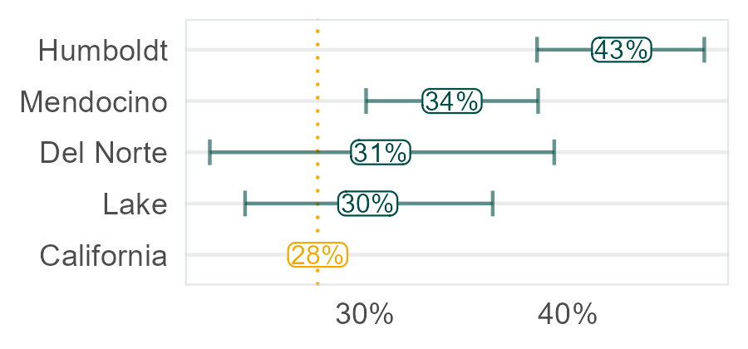
Motor Vehicle Traffic Crashes
Percent of Driving Deaths Involving Alcohol
Substance use appears to play a critical role in the region’s elevated motor vehicle deaths.
Data: County Health Rankings and Roadmaps, 2016-2020
OTS Crash Risk Rankings
Data: California Office of Traffic Safety, 2017 -2020 Average
Notes:
(SECOND CHART) The Office of Traffic Safety ranks each California county from 1 (worst) to 58 (best) for each criteria above. Gold and Yellow on the chart indicate higher risk. You can see that there is a clear trend of higher risk in the region for pedestrian, hit-and-run, nighttime, and alcohol-involved fatal and injury traffic accidents in the Redwood Coast Region.
There appears to be very serious risk for Mendocino County in the alcohol involved category.

Slide 17
Suicides and Firearm Deaths
Mendocino, and the greater Redwood Coast Region, have elevated rates of both suicides and firearm-related deaths. Multiple data sources strongly signal higher risk factors for suicide:
“Have you ever seriously thought about committing suicide?”
Data: California Health Information Survey (CHIS) 2011-2022 (HML = Humboldt, Mendocino, Lake)
Notes:
Suicides and firearm-related deaths are categorized together because suicides constitute more than half of firearm deaths on a national scale.
Studies have shown a strong link between suicide ideation and completion, and therefore, suicide ideation can be a proximate explanation for the elevated suicide and firearm-related mortality rates.

Slide 18
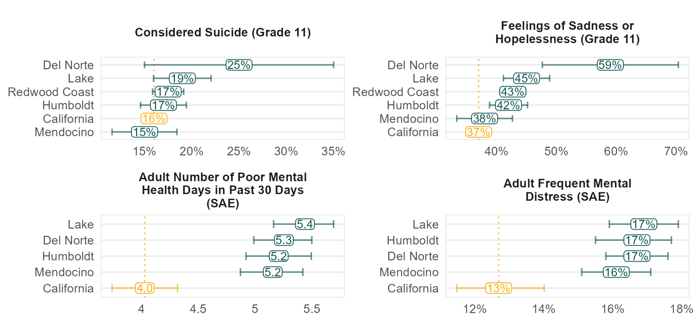
Risk Factors for Suicide & Firearm Deaths
Mental Health Indicators
Data: Adult estimate from County Health Rankings and Roadmaps (CHRR) 2020, Youth data from CalSCHLS 2017-2019

Slide 19
Smoking is a Risk Factor for Mendocino County
Smoking Rates
The Redwood Coast Region has high rates of smoking, and elevated mortality rates for all cancers. However, Mendocino County appears to have moderately elevated rates of cancer and chronic lower respiratory disease deaths.
Data: California Health Information Survey 2011-2022
Smoking, Percent of Population
Data: (Adult Estimate, County Health Rankings and Roadmaps 2020, Youth Data, CalSCHLS Data 2019-2021)
Notes:
Important for the smoking rates chart to understand that all categories (current smoker, former smoker, and never smoked) all add up to represent 100% of the population categories.

Slide 20
Economic, Social Institutional, and Environmental Factors
Notes:
This section of the report analyzes factors drawn from the Social Determinants of Health Framework and considers related factors that are broadly discussed in the region’s Community Health Assessments (CHA).
The Social Determinants of Health encompass five key themes: (a) economic stability (b) educational access (c) health access (d) neighborhood environment (e) social context.
This study does not attempt to establish direct cause-and-effect relationships between the Economic, Social, Institutional, and Environment factors and proximate risk factors or health outcomes, however it investigates the connections between them.

Slide 21
Socioeconomic Factors - Poverty
The entire Redwood Coast Region has significantly higher rates of poverty than the state as a whole.
Poverty is linked to:
Lower life expectancy;
Increased health risks related to obesity, smoking, substance use, and chronic stress (Healthy People 2030).
Poverty Rates
Data: American Community Survey (ACS) 2017-2021

Slide 22
Risk Factors by Income Range
Poverty in the Redwood Coast appears to be strongly connected to smoking and suicide ideation, with a higher disparity for people who live under the federal poverty line (FPL).
Proximate Risk Factors by Income Range
Data: Community Health Information Survey (CHIS) 2011-2021, Binge Drinking from 2011-2015

Slide 23
Socioeconomic Factors - Educational Attainment
The Redwood Coast Region, minus Del Norte, have achieved high school graduation rates on par or exceeding the state average.
However, all counties lag behind in four-year degree attainment.
Research suggests that those with higher education levels are less prone to certain preventable illnesses/mortalities such as:
Lung cancer;
Respiratory diseases;
Homicides;
And accidents.
Educational Attainment, Population 25 Years or Older
Data: American Community Survey (ACS) 2017-2021
Notes:
Source: Hernandez and Hummer, 2013 The Effect of Educational Attainment on Adult Mortality in the United States. Popul Bull, 68(1):1-16. PMID: 25995521; PMCID: PMC4435622.
In recent decades, smoking has become strongly associated with education levels. In the late 1960s, approximately 40% of college-educated people smoked compared to 45% of people without a college education, but the proportion of college graduates who smoke has fallen faster than that of those without a college degree. More recently, just 6.5% of college graduates smoke compared to 23.1% for those with a high school diploma or less (Cahn et al., 2018).

Slide 24
Risk Factors by Educational Attainment
Education levels particularly impact smoking rates in the Redwood Coast Region, with one in four individuals with less than a high school diploma being a current smoker, compared with 14% statewide.
Proximate Risk Factors by Education
Data: Community Health Information Survey (CHIS) 2011-2022, Binge Drinking from 2011-2015

Slide 25
Social Factors - Social Isolation
Significantly more householders live alone in the Redwood Coast, indicating greater levels of social isolation within the household context. Further analysis found that more men in the HML region live alone.
Isolation is a critical risk factor for suicide, particularly among men, who are about four times more likely to commit suicide compared to women (CDC, 2023).
Householders Living Alone, Percent of Households
Data: American Community Survey (ACS) 2017-2021

Slide 26
Risk Factors by Isolation
Living alone appears to be positively associated with smoking and suicide ideation, with 22% of adults living alone being a current smoker, and nearly a quarter of adults living alone having considered suicide.
Proximate Risk Factors by Isolation, Gender, and Age
Data: Community Health Information Survey (CHIS) 2011-2021
Notes:
While there is only a slightly higher rate of suicide ideation among men who live alone, studies show that men tend to be more likely to die from a suicide attempt compared to women, as men tend to choose more lethal means of suicide such as firearms (National Institute of Mental Health). The impact might result in more completed suicide attempts by men, even if the probability of suicide ideation between men and women aren’t drastically different.

Slide 27
Social Factors - Adverse Childhood Experiences (ACEs)
The proportion of adults with four or more ACEs is significantly and substantially higher in the Redwood Coast compared to the state average, while the percentage of adults with zero ACEs is significantly lower.
People with multiple ACEs have greater risk of poor health outcomes or behaviors including depression, substance use, and tobacco use (Center on the Developing Child). ACEs include abuse, neglect, household mental illness and substance abuse. (Anda et al., 1998).
Number of ACEs Among Adults, Percent of Population
Data: California Health Information Survey (CHIS) 2021-2022
Notes:
Adverse Childhood Experiences (ACEs) are potentially traumatic events that occur in childhood. ACEs can include violence, abuse, and growing up in a family with mental health or substance use problems. Toxic stress from ACEs can change brain development and affect how the body responds to stress. ACEs are linked to chronic health problems, mental illness, and substance misuse in adulthood.

Slide 28
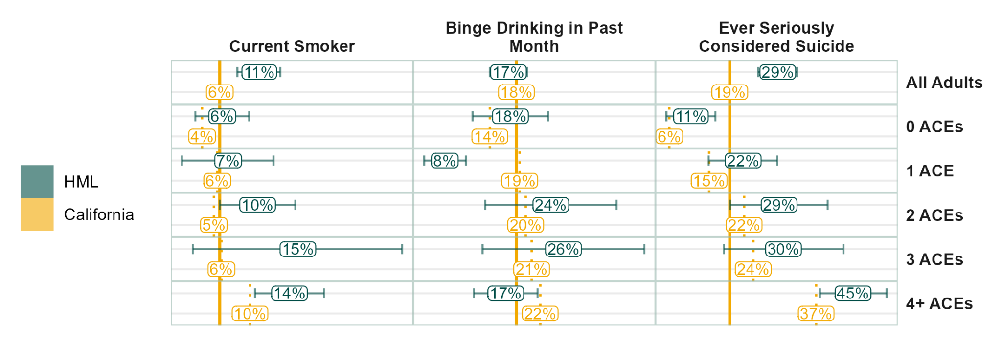
Risk Factors by Number of Adverse Childhood Experiences
Redwood Coast adults with four or more ACEs have seriously contemplated suicide during their lives compared to just 11% of Redwood Coast adults with no ACEs and 6% of California adults with no ACEs. Therefore, Redwood Coast residents indicating multiple ACEs are at high risk for one of the region’s most elevated causes of death.
Proximate Risk Factors by Isolation, Gender, and Age
Data: Community Health Information Survey (CHIS) 2021-2022
Notes:
ACEs data are available only for 2021. To make cross variable comparisons, the data must share a year in common. Binge Drinking in the Past Month is available for the 2021 year whereas Binge Drinking in the Past Year is not. Current Smoker with 1 ACE is statistically unreliable.

Slide 29
Community and Institutional Factors - Homelessness
PIT counts indicators suggest an elevated homelessness rate across the region, with Mendocino having the highest rates in the state.
People experiencing homelessness face a significantly higher risk of premature death, chronic disease, depression, and substance use (Collins 2016).
Total Counted Experiencing Homelessness per 100,000 by Continuum of Care
Data: U.S. Department of Housing and Urban Development Point-in-Time (PIT) Estimates 2016-2020
Notes:
Source: Collins, S. E. (2016). Associations Between Socioeconomic Factors and Alcohol Outcomes. Alcohol Research, 38(1): 83-94. PMID: 27159815; PMCID: PMC4872618.
Local data on the connection between homelessness and health is limited, state-level data reveals that public school students experiencing homelessness have substantially higher rates of cigarette smoking, substance use, and suicidal thoughts compared to peers not experiencing homelessness (CalSCHLS).

Slide 30
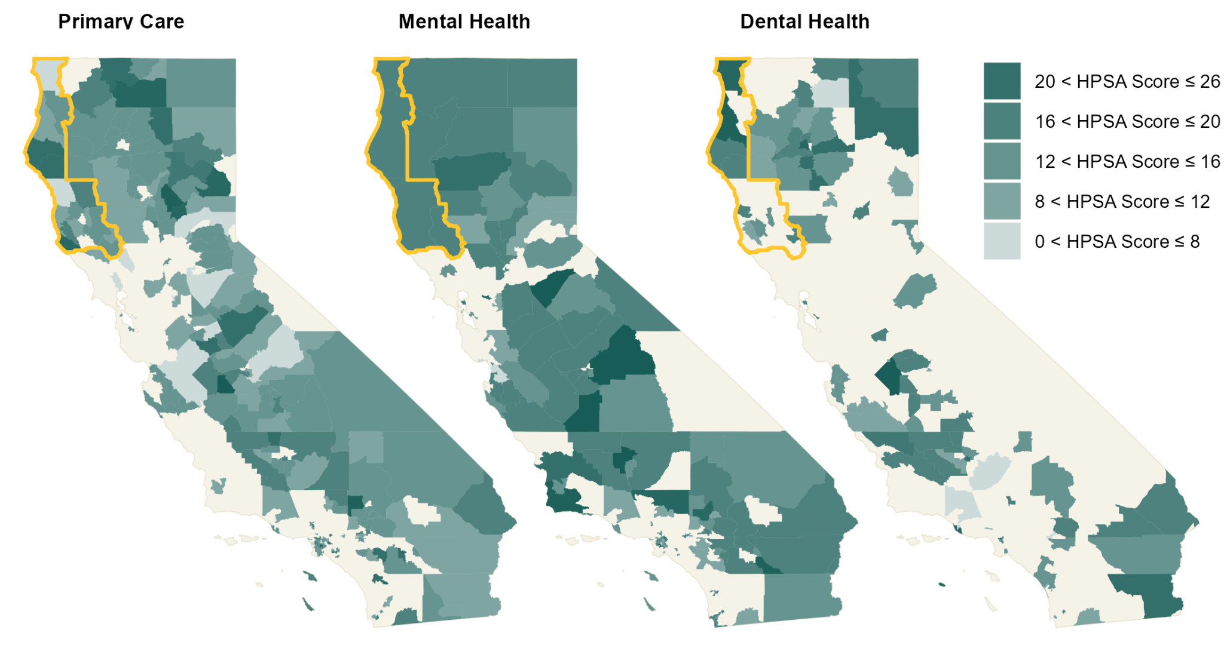
Community and Institutional Factors - Healthcare Access and Barriers
Health Professional Shortage Areas and Scores
The majority of the Redwood Coast is a designated Health Provider Shortage Area (HPSA): regions or populations identified by the U.S. Department of Health and Human Services (HHS) as having a shortage of primary care, mental health, or dental health providers.
Data: Health Resources and Services Administration, 2023
Notes:
Note that beige areas on the maps are not HPSAs. Emerald areas are HPSAs, with darker hues indicating higher scores and greater need.

Slide 31
Community and Institutional Factors - Healthcare Access and Barriers
A significantly larger proportion of the Redwood Coast population has recently experienced delays in accessing primary healthcare in contrast to the state population.
Delayed care is associated with higher mortality in prostate, breast, and colorectal cancer rates.
Delayed Healthcare, Percent of Total Population
Data: California Health Information Survey (CHIS) (Left 2011-2022, Right 2013-2022)
Notes:
Source for Colon and Breast: Chan VW, Tan WS, Asif A, Ng A, Gbolahan O, Dinneen E, To W, Kadhim H, Premchand M, Burton O, Koe JS, Wang N, Leow JJ, Giannarini G, Vasdev N, Shariat SF, Enikeev D, Ng CF, Teoh JY. Effects of Delayed Radical Prostatectomy and Active Surveillance on Localised Prostate Cancer-A Systematic Review and Meta-Analysis. Cancers (Basel). 2021 Jun 30;13(13):3274. doi: 10.3390/cancers13133274. PMID: 34208888; PMCID: PMC8268689.
Source for Prostate: Hanna T P, King W D, Thibodeau S, Jalink M, Paulin G A, Harvey-Jones E et al. Mortality due to cancer treatment delay: systematic review and meta-analysis BMJ 2020; 371 :m4087 doi:10.1136/bmj.m4087
The federal poverty level for 2024 coverage is $14,580 for an individual and $30,000 for a family of 41. This is an increase from the federal poverty level for 2023 coverage, which was $13,590 for an individual and $27,750 for a family of 41. The federal poverty level for 2022 coverage was $12,880 for an individual and $26,500 for a family of 41. The federal poverty level is used to determine eligibility for certain government programs and subsidies, such as Medicaid expansion and premium tax credits2

Slide 32
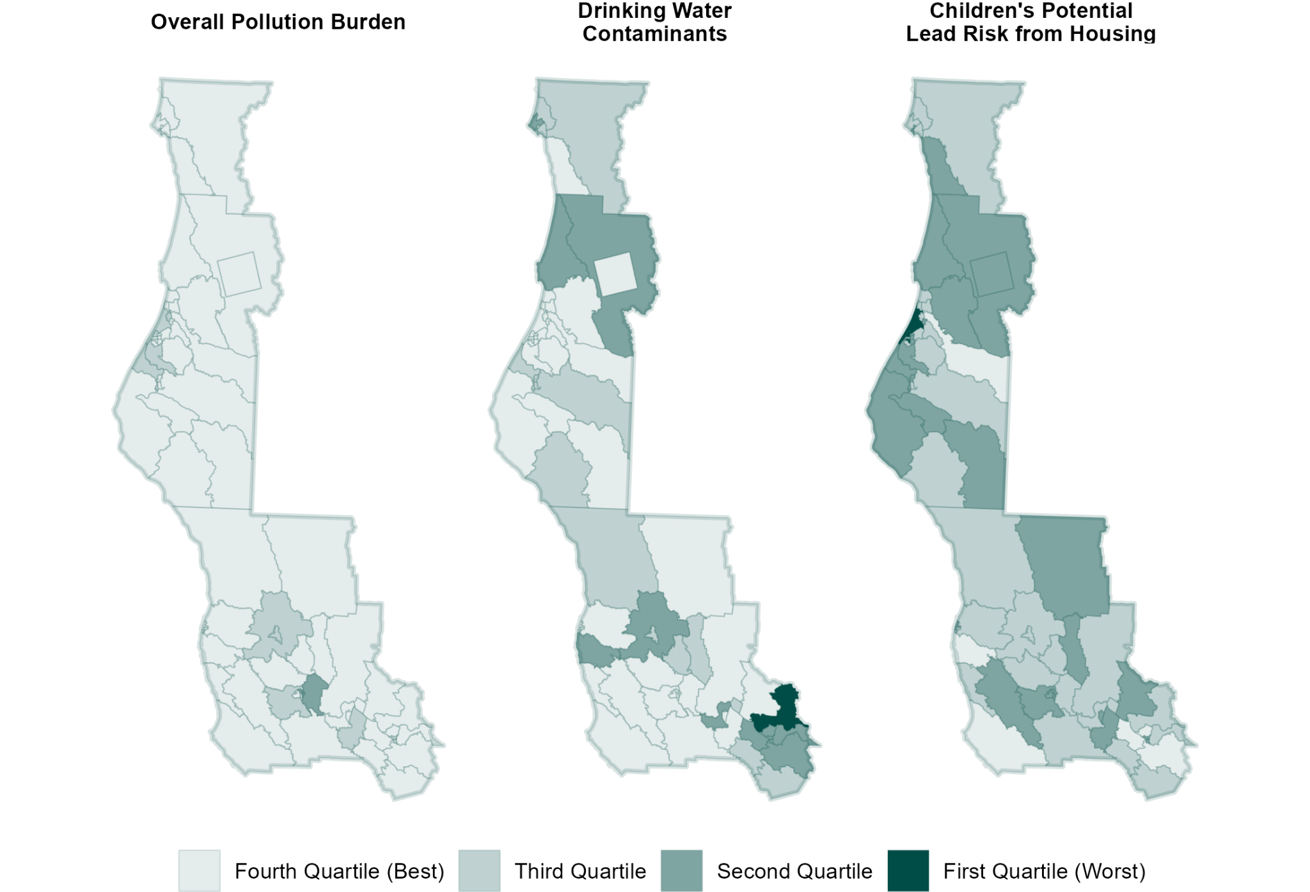
Environmental Factors - Environmental Quality Indicators
CalEnviroScreen 4.0 Risk Factors
Environmental pollutants can contribute to respiratory disease, heart disease, and some cancers (Healthy People 2030, “Environmental Health”). As shown below, CalEnviroScreen 4.0 data indicate that overall the region’s pollution burden is lower than the statewide estimates.
Data: CDPH, CalEnviroScreen 4.0
Notes:
Not including data on blood lead levels for children as Mendocino’s rate is below the state average. It is a risk factor for the Redwood Coast Region as a whole though.

Slide 33
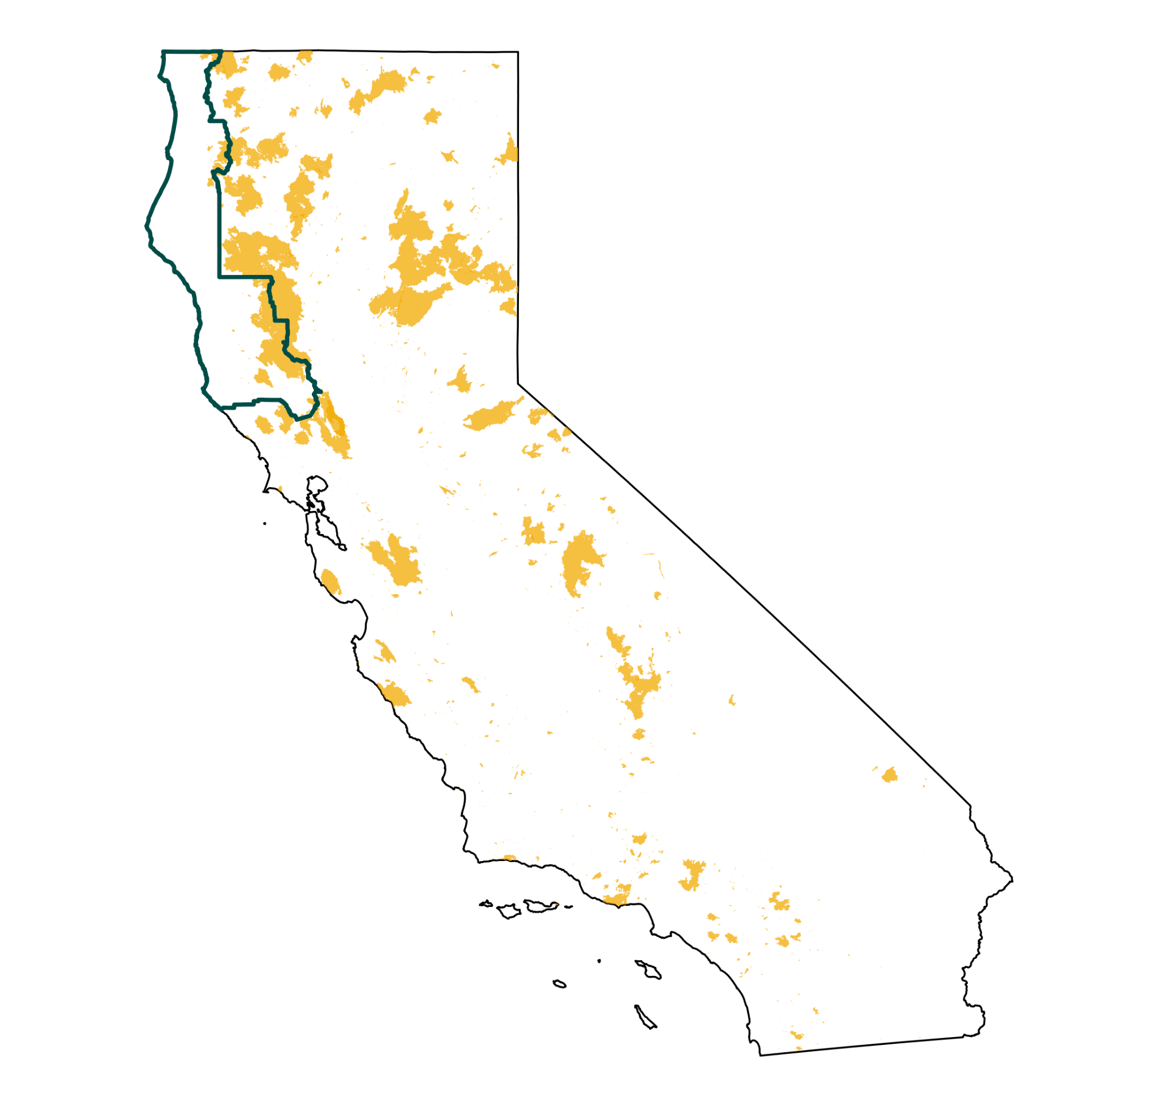
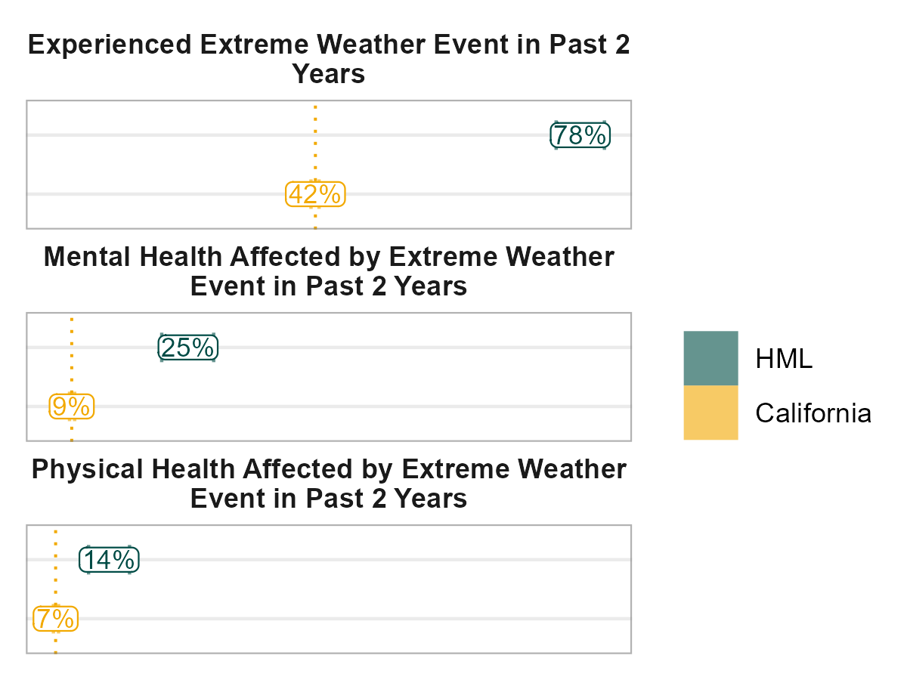
Environmental Factors - Wildfires
Wildfires and corresponding health risks have in recent years been far more severe in the northern region of the state.
Smoke from wildfires can impair lung function, contribute to bronchitis, asthma, and heart failure; the region’s substantial elderly population are particularly vulnerable to these effects (United States Environmental Agency, 2023).
Health Effects of Extreme Weather Events, Percent of Population
Wildfires, Burned Area
Data: California Health Information Survey (CHIS) 2021-2022
Data: California Department of Forestry and Fire Protection 2018-2022

Slide 34
Health Equity Analysis and Vulnerable Populations

Slide 35
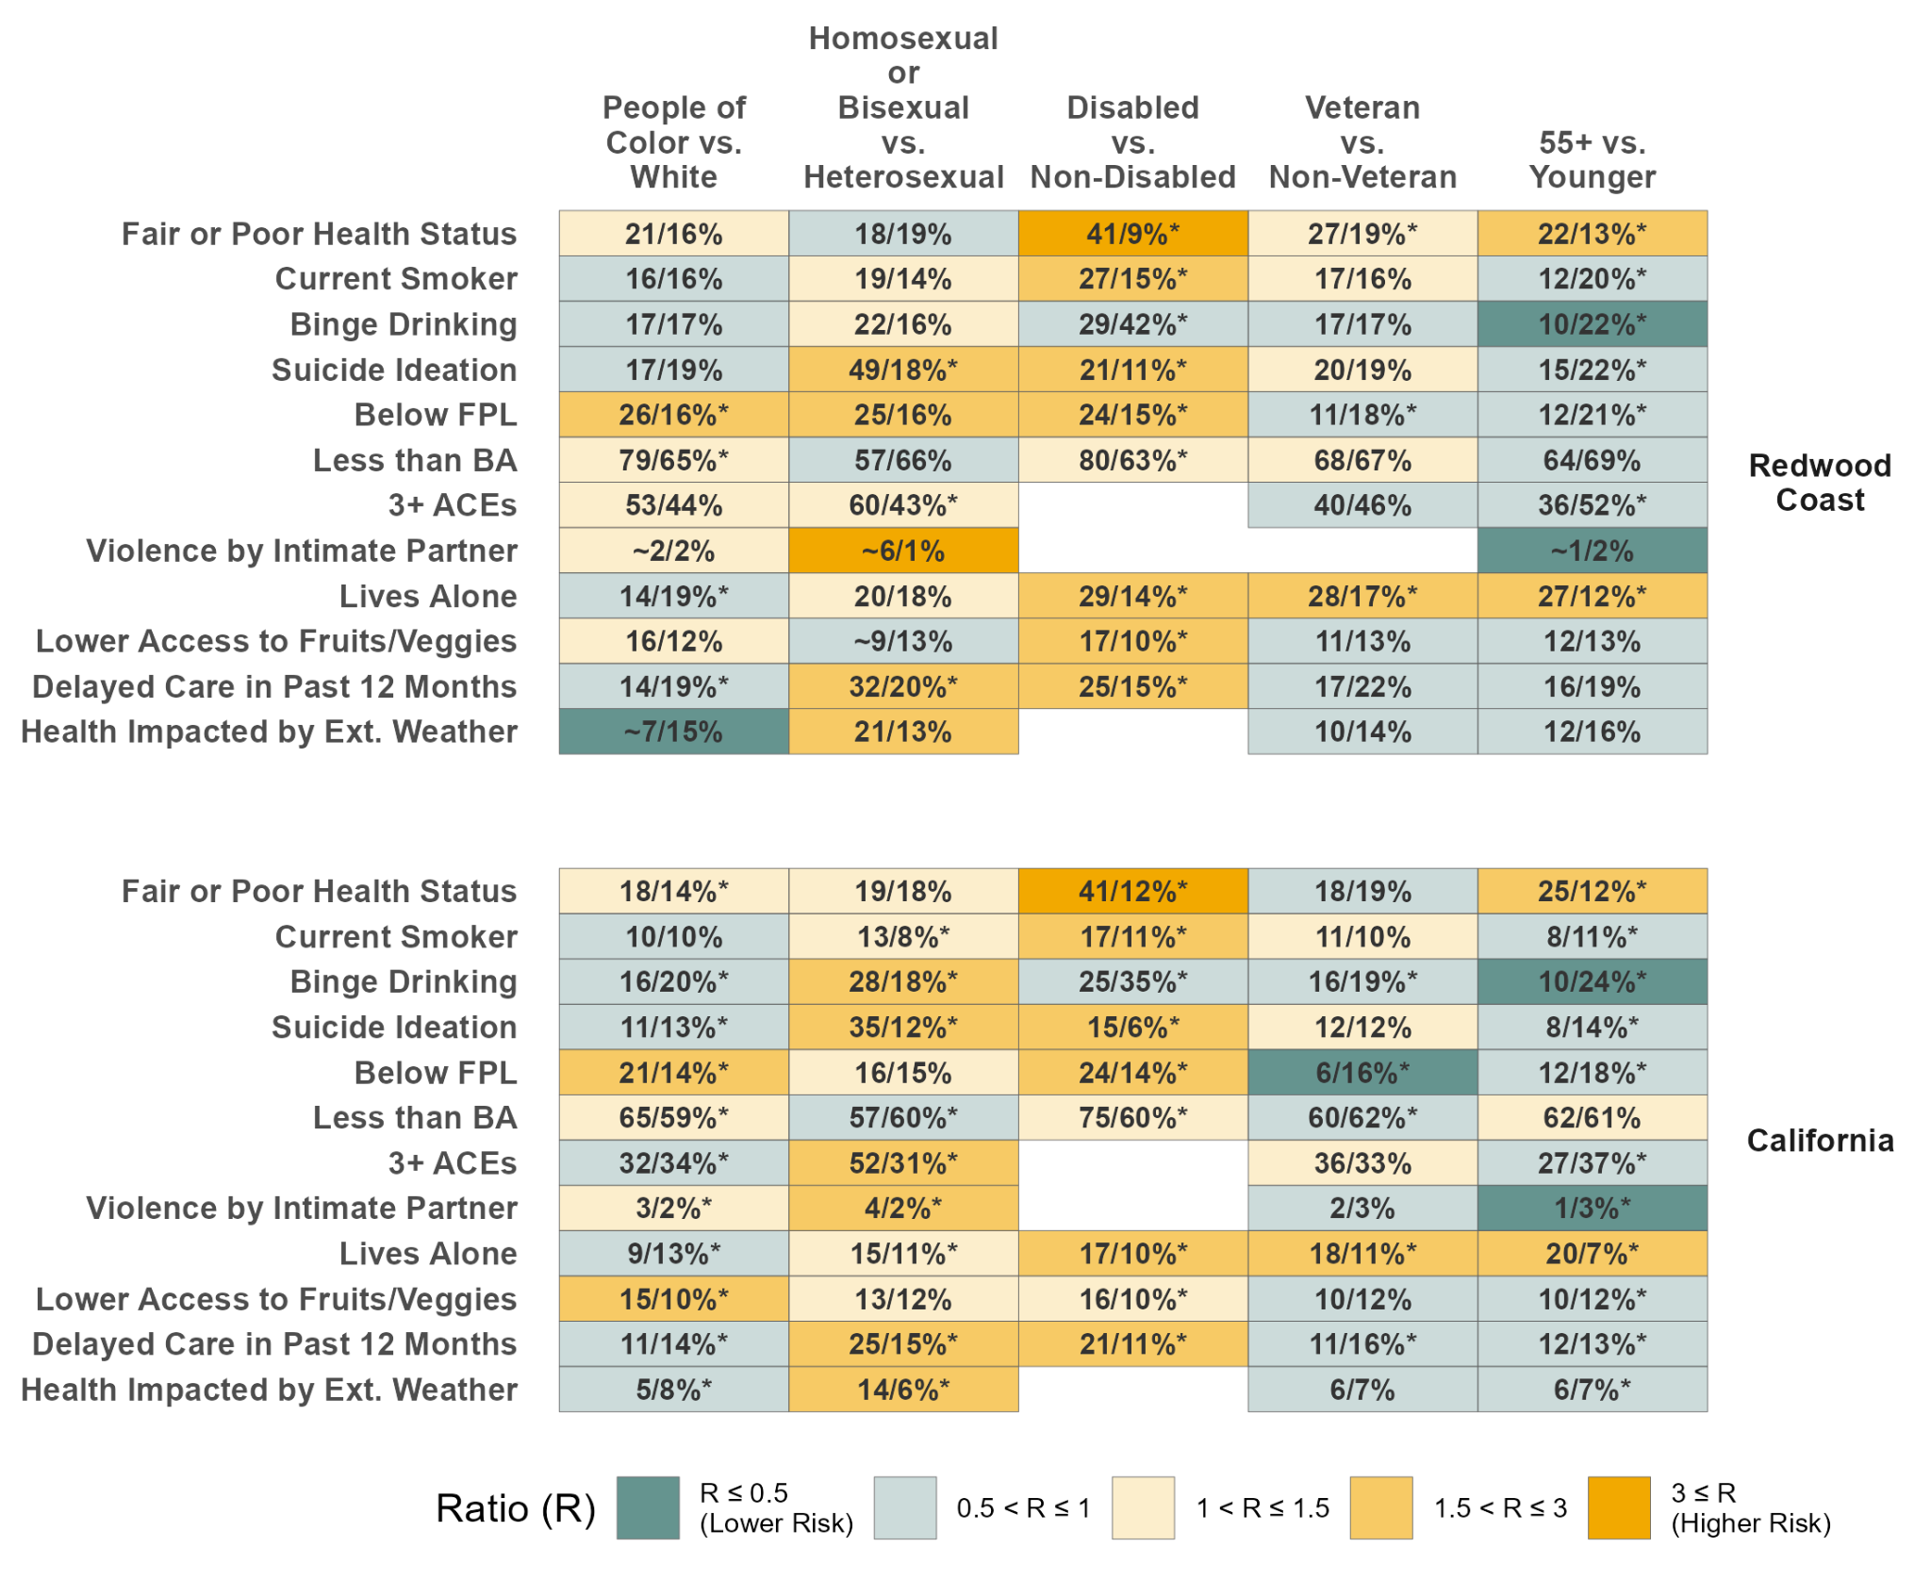
Notes:
Data sourced from the CHIS 2011-2022
Focus on highest risk in yellow

Slide 36
Notable Trends from Equity Analysis
People of color show higher rates of fair or poor health, higher poverty levels, lower educational attainment, higher ACEs, and more limited access to nutritious foods.
Lesbian, gay, and bisexual communities within the HML region face numerous disparities: increased smoking and heavy alcohol consumption, suicidal thoughts, higher poverty rates, elevated ACEs rates, domestic violence, deferred medical care, and adverse weather-related health impacts. Alarmingly, half of this community has seriously contemplated suicide.
People with disabilities in the region experience higher rates of poor health, increased smoking, suicidal thoughts, poverty, lower educational attainment, living alone, restricted access to healthy food, and deferred medical care.
The 55+ demographic in the region tends to live solitarily. As expected, a higher percentage report fair or poor health, but this group generally has fewer risk factors. The health trends of the veteran population resemble these patterns, possibly due to a significant age overlap in these two groups within the region.

Slide 37
Areas of Focus and Recommendations

Slide 38
Policy Focus Area 1:
Smoking Prevention, Education, and Cessation
Policy Focus Area 2:
Substance Use Prevention and Treatment
Policy Focus Area 3:
Suicide Prevention and Access to Mental Health Care

Slide 39
2023 Mendocino County Community Health Improvement Plan
Key Priority Areas:
Improve Maternal Health
Identify strategies to increase coordination between providers and managed care to improve maternal health
Increase home visiting nurses and community health workers for perinatal and postpartum care throughout the county
Work with hospitals and clinics to encourage medical residents to consider training in remote parts of the county
Improve transportation options for getting to appointments
Improve Adolescent Health
Work with Mendocino County Office of Education and schools to assess and advance the equitable delivery of sexual and reproductive health, following The California Healthy Youth Act of the California Education Code (Children in Foster Care) in all regions of the County
Increase the availability and access to reproductive health services, to reduce the number of teen pregnancies and sexually transmitted diseases and STD treatment
Promote continuing health education in schools to address issues like reproductive health, dating violence, sexual violence, drug abuse, motor vehicle accidents, promotion of healthy relationships etc., along with peer education programs; Distribute educational materials to increase awareness
Identify gaps in services for youth in foster care
~Social isolation and loneliness appear to be potential risk factors for the health challenges in the regions
…promoting quality social connections may therefore be effective approaches to improving the region’s health~

Slide 40
How To Reach Us
Leigh Pierre-Oetker, Senior Research Analyst
lao3@humboldt.edu
Dawn Arledge, Executive Director
Dawn.Arledge@humboldt.edu
Devin Flynn, Research Analyst
Devin.Flynn@humboldt.edu
www.ccrp.humboldt.edu

